Slide 1
Let’s Talk About Sex ACBS!
Awareness, Acceptance, Courage, Love, Defusion, Presence, Values, Perspective Taking and Behaviorism in talking about Sex Personally and Professionally
Aisling Curtin, M.Sc.

Slide 2
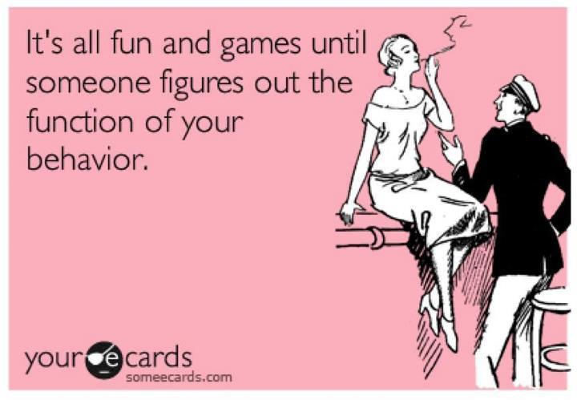

Slide 3
An Invitation: 3 zones
Where the magic happens
Self-care zone
Comfort zone
Thanks Benji Schoendorff

Slide 4
Five Sexual Words You Find Uncomfortable

Slide 5
Vision for this Let’s Talk about Sex Workshop
An environment where you are reinforced as powerful thinkers and agents of change, not only in the therapy room, but in your daily lives.
A place with no pretenses, where we can be seen and heard as who we are, where we express our true voice, where our wounds are validated and our gifts are nurtured.
Confidentiality: All personal disclosures we make, verbal or written, are absolutely confidential. This extends to anything the workshop leader may disclose in the service of modeling.
Needs: Make your needs known. Ask for what you want and don’t want.
Presence and emotional risk: Challenge yourself to be outside of your comfort zone, to go deeper than you are typically comfortable into learning, thinking, feeling, being, and expressing. But be gentle with yourself at the same time.
(Adapted from Mavis Tsai)
Notes:
Anita

Slide 6
What is at the heart of this suffering?
Words make feared
futures feel real, and
our past live
in the present.
Notes:
Words can even do magic. Do chocolate cake exercise…

Slide 7
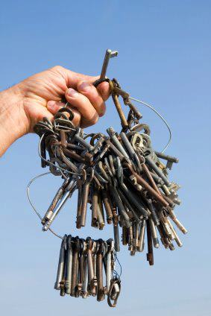
Acceptance
The curious paradox is
that when I accept myself
just as I am,
then I can change. Carl Rogers
Notes:
Invitation to engage in 3 experiential exercises I created/adapted from existing exercise to evoke awareness of CRB1s/T1s & CRB2s/T2s

Slide 8
The Power of Vulnerability- Yes
Notes:
An exercise I developed from Tara Brach’s yes/no meditation. Firstly noticing all our unwanted internal content- thoughts, emotions & bodily sensations and deliberately saying “no” to each of these experiences. And then saying “yes” and cultivating an open willing attitude to our internal experiences around sex/sexuality. Drawing a parallel between this and what goes on in the therapy room. Do we sometimes say the words of yes yet carry the energy of no when we are talking about sex with clients. What might the impact of this be?

Slide 9
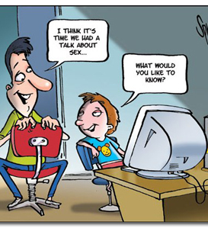
What is it like to be your Client when you are talking about Sex?
What ways do you subtly show your discomfort?
What elements of your learning history impact how you approach sex in therapy?
What does it look like when you potentially punish your client when they talk about sex?

Slide 10
Perspective Taking
Mindfulness exercise where we connect to vulnerabilities in relation to values in our sexual life & then expanding this to professional life

Slide 11
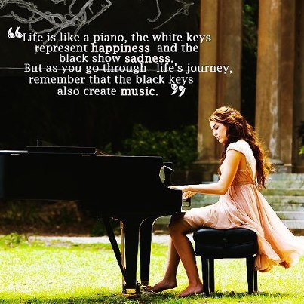
Common Humanity
Write 1 vulnerabilities in relation to your sexual learning history that you would usually have difficulty in sharing & place this randomly face down on the floor
Look at all that is on the floor & follow common humanity exercise
Debrief in pairs about any part of these experiential exercises

Slide 12
Bringing ACL into Talking about Sex
Awareness
Noticing, attention
Mindfulness, being present
Empathic connection
Attunement
Perspective taking
Courage
Love
Being honest
Vulnerability
Authenticity
Taking a risk, making a commitment
Confronting
Asking bold questions
Trying new things, making effort
Caring, altruism
Showing compassion
Supporting
Appreciating
Acknowledging
Respecting
Connection
Notes:
I like to have this in the background during real-play so that the participant’s can identify the processes of ACL in action

Slide 13
Adapted Box Questions
Box A
What would constitute a "perfect day" for you?
What is one of the things in your life you feel grateful for?
If you could wake up tomorrow having gained any one quality or ability, what would it be?
Box B
If you could change anything about the way you were raised in terms of attitudes towards sex, what would it be?
If you knew that in one year you would die suddenly, would you change anything about the way you are now living in terms of sexual/sensual intimacy? Why?
What do you most value in a sexual/intimate relationship?
Box C
Share an embarrassing or shameful moment in your life in relation to your sexual learning history.
Tell me about something or someone you have lost in your life that you believe affects you sexually/intimately today.
What is a painful sexual/intimate memory for you? Have you come to terms with what happened? If yes, how? If no, is there anything you would like to do to resolve what happened so that it eases your pain around this?
Notes:
My variation on the box questions adapted for sexual learning history. I have left box A the same so that people don’t feel cohersed into talking about sex if this is too far beyond their comfort zone/self-care zone, as in Benji’s diagram

Slide 14
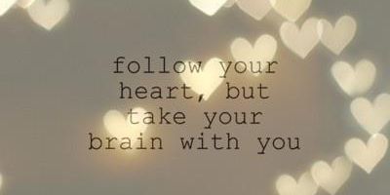
Talking about Sex with ACL Real-Play
Notes:
I will do a 20-minute real-play with someone in-vivo in the room

Slide 15
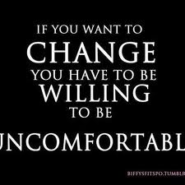
And...

Slide 16
Thank you so much for taking time to talk about Sex!
aacurtin@tcd.ie
www.actnowireland.com
Find ACT Now Ireland on Facebook
Find WTF Psychology Blog

